Slide 1

RMS Titanic: Learning from a disaster
Bhavishya pawar Rajgarhia
Yashi Srivastava
Aditi Srivastava

Slide 2
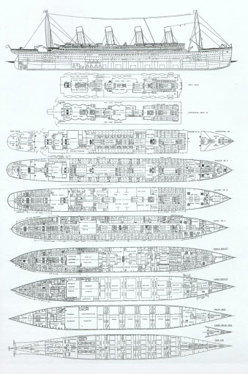
RMS Titanic
The RMS Titanic was a British passenger liner that sank in the North Atlantic Ocean in the early morning hours of 15 April 1912, after it collided with an iceberg during its maiden voyage from Southampton to New York City. There were an estimated 2,224 passengers and crew aboard the ship, and more than 1,500 died, making it one of the deadliest commercial peacetime maritime disasters in modern history. The RMS Titanic was the largest ship afloat at the time it entered service and was the second of three Olympic-class ocean liners operated by the White Star Line. The Titanic was built by the Harland and Wolff shipyard in Belfast. Thomas Andrews, her architect, died in the disaster.

Slide 3
Libraries Used
Purpose | Libraries
Mathematical Calculations | Numpy
Data Processing | pandas
Data Visualization | seaborn, matplotlib.pyplot, matplotlib.style
Algorithms | sklearn.linear_model.LogisticRegression, sklearn.neighbors.KNeighborsClassifier, sklearn.svm.SVC, sklearn.naive_bayes.GaussianNB, sklearn.tree.DecisionTreeClassifier, sklearn.ensemble.RandomForestClassifier

Slide 4
Data Dictionary
Variable | Definition | Key
Survival | Survival | 0= No, 1= Yes
Pclass | Ticket Class | 1= 1st, 2= 2nd, 3= 3rd
Sex | Sex
Age | Age in years
SibSp | No of Siblings and Spouse aboard on the Titanic
Parch | No of parents and Children aboard on the Titanic
Ticket | Ticket Number
Fare | Passenger Fare
Cabin | Cabin Number
Embarked | Port of Embarkation | C= Cherbourg, Q= Queenstown, S= Southampton

Slide 5
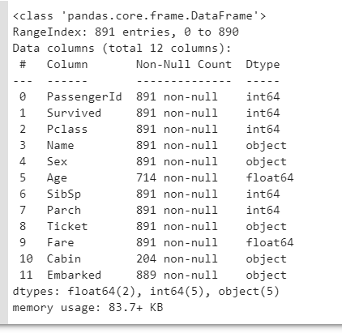
Training Set
The Training set has 891 examples and 11 features + the target variable(Survived).
5 of them are int64 type.
5 of them are object type,
2 of them are float64 type
We would have to change the object features into numeric value to get a viable result from the machine learning algorithm.

Slide 6
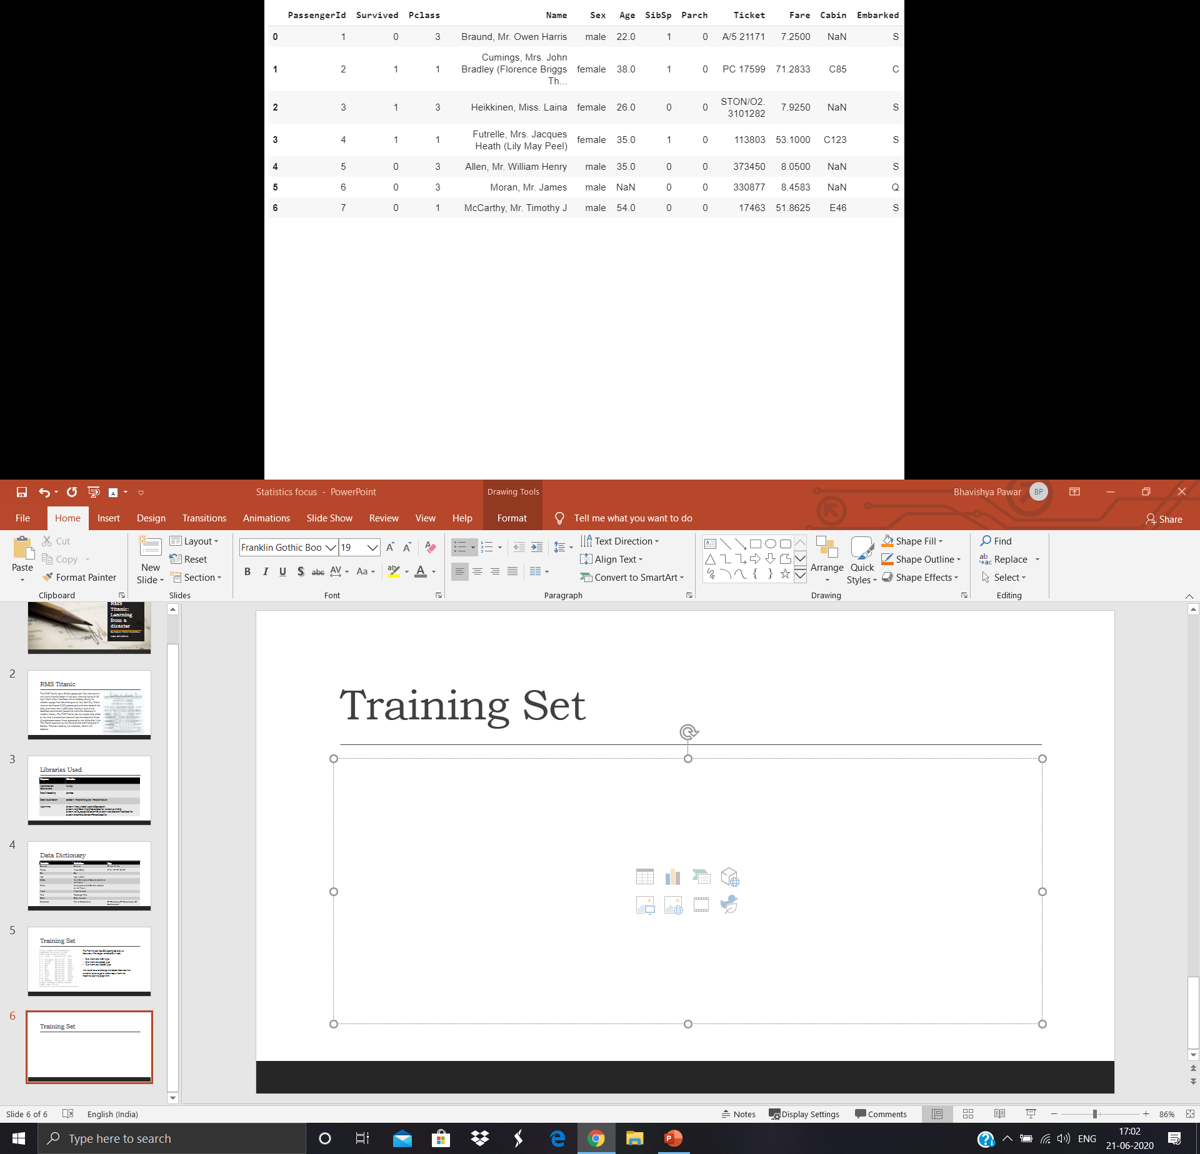
Training Set
We can see that the range of the features differs a lot, we’ll have to convert them into same scale. We can also see that there are features with missing values(NaN: Not a Number), well have to deal with those values.

Slide 7
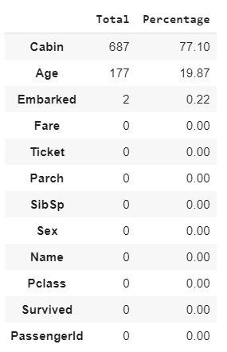
Missing Values
Embarked feature has only two missing values, so it would be easy to handle, but Cabin and Age features are certainly going to be complicated to handle, with 19.87 % missing data in age and 77.10% missing data in Cabin.

Slide 8
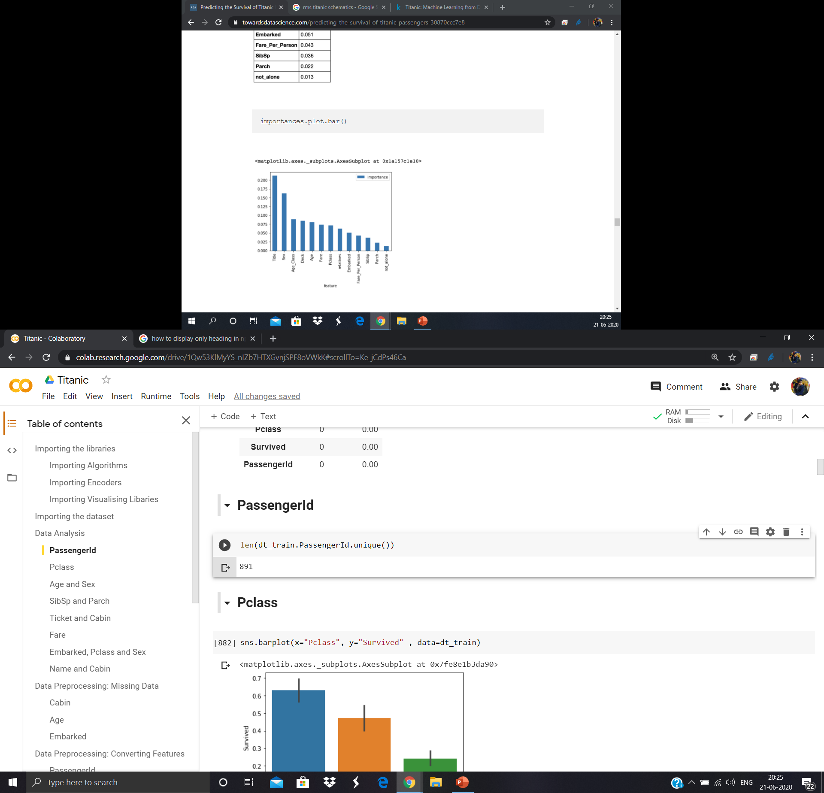
Data Analysis: PassengerId
PassengerId has 891 unique values, which is same as the number of total values, so it is understandable that this feature would amount to nothing for prediction of Survival. So we would just remove this from our data.

Slide 9
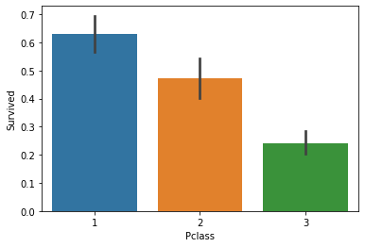
Data Analysis: Pclass
Here, when we compare Pclass with survival, it is evident that people who were in first class had higher chance of survival than people in third class.
Also this depicts the socio-economic status of passengers, as passengers who were in first class belonged to higher socio-economic background and passengers who belonged to third class belong to lower socio-economic background.

Slide 10
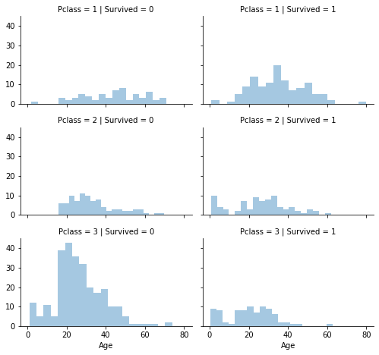
Data Analysis: Pclass
Now the graph on the left shows us that passengers in
First class have higher probability of surviving than not surviving
Second class have almost equal probability of surviving and not surviving
Third class have higher probability of not surviving than surviving which is opposite of probability of passengers in first class’s survival

Slide 11
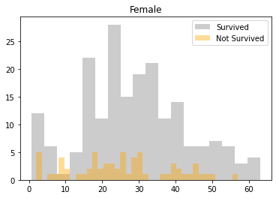
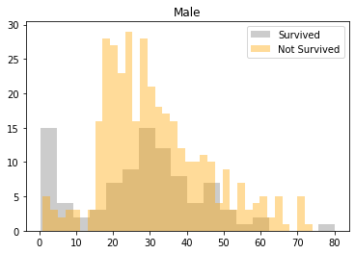
Data Analysis: Age and Sex
Female: The probability of surviving is higher for females, and particularly very high if age is between 0-4 and 15-42 years of age.
Male: The probability of surviving is lower for males. Only males between the age of 0 - 5, 18 – 38, 44 – 48 years of age. The probability of male surviving is comparable to the males not surviving, which is vice versa of the situation for female survival.

Slide 12
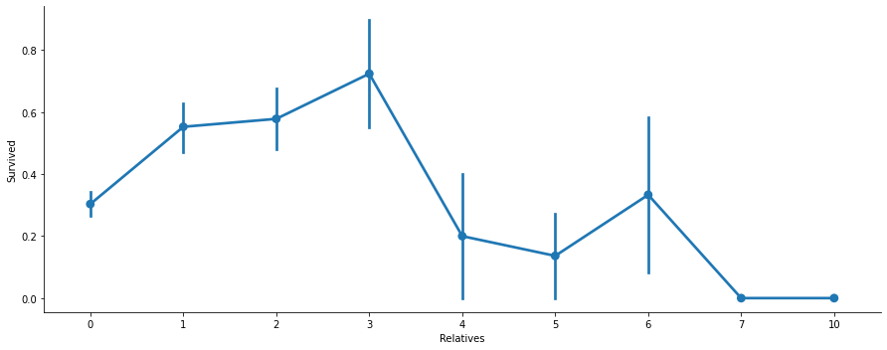
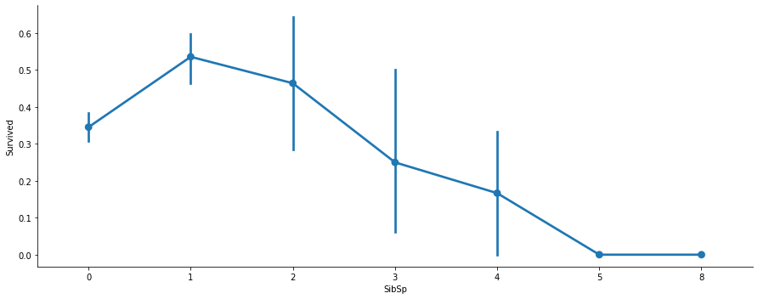
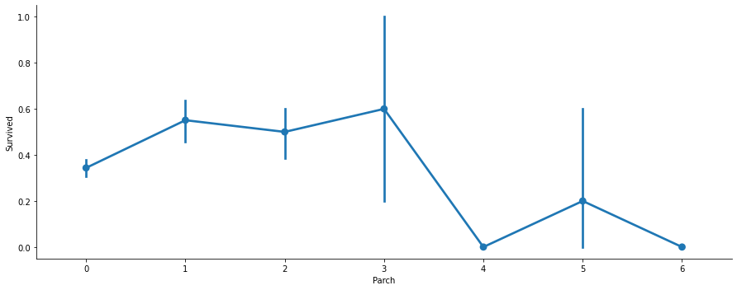
Data Analysis: SibSp and Parch
SibSp and Parch makes much more sense as a single feature than being separate, as it is visible by the three graphs that the relatives graphs shows more equal distributions that SibSp and Parch features alone.

Slide 13
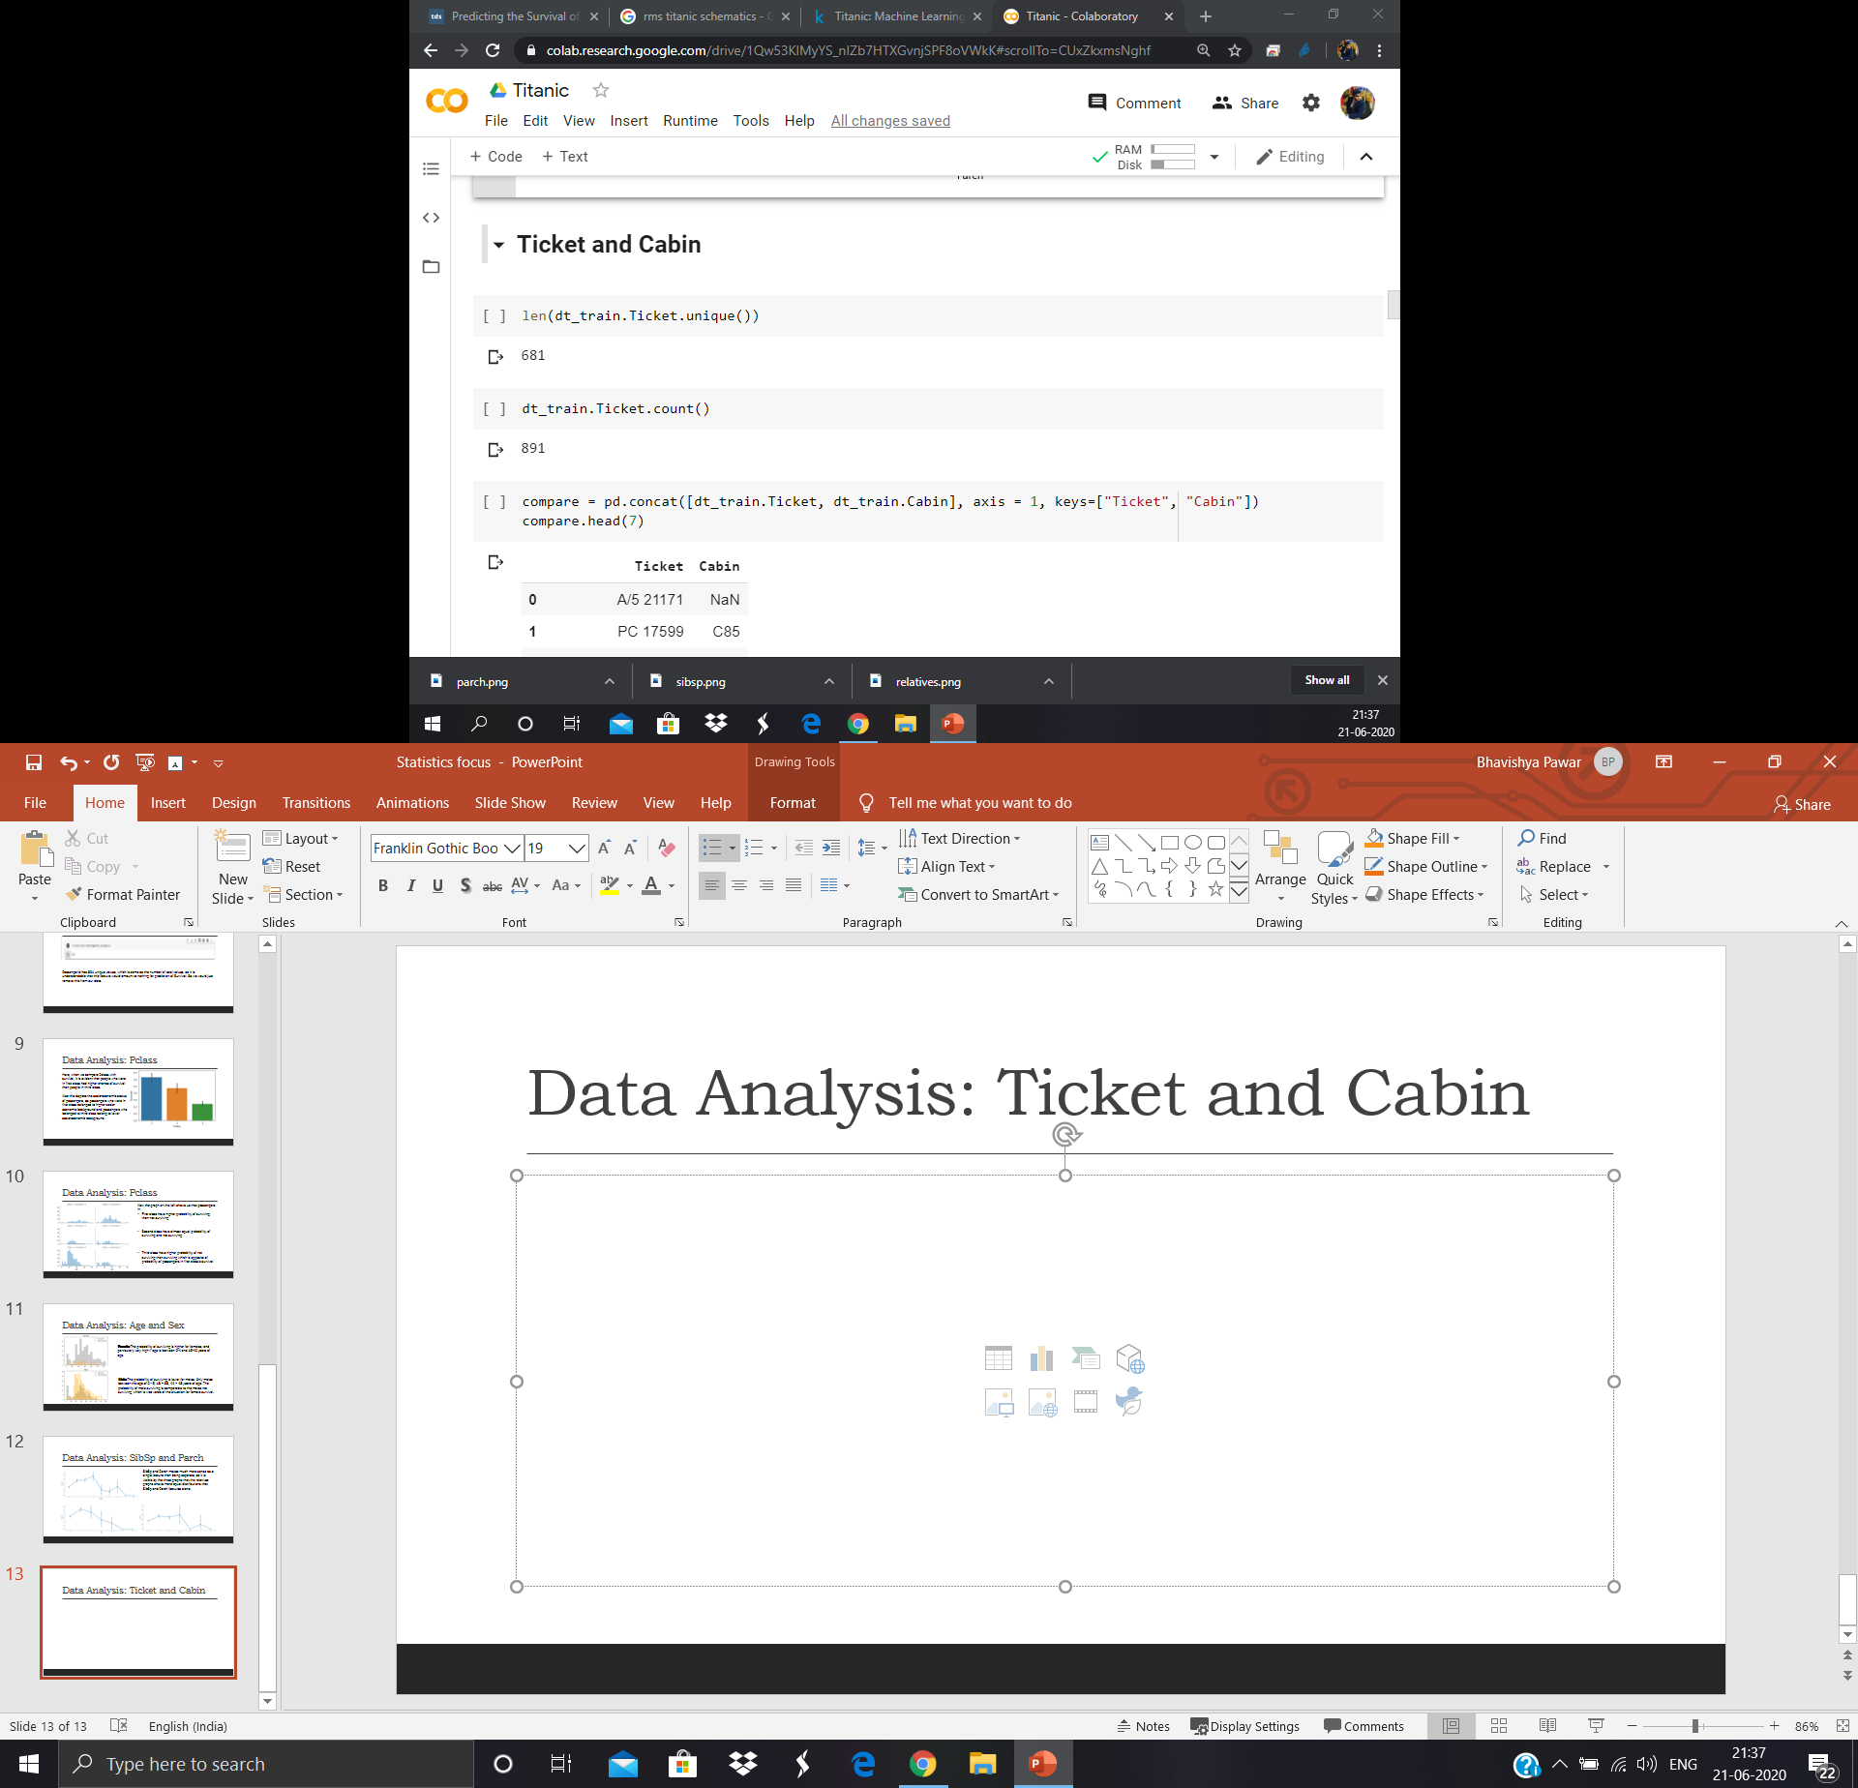

Data Analysis: Ticket and Cabin
Here, ticket has about only 681 unique values out of 891 total values, so we could use the duplicates to fill in missing values of cabin as cabin and ticket is bound to have a correlation
After filling missing values of cabin with ticket’s value, the amount of missing values has changed by an 1.23%.

Slide 14
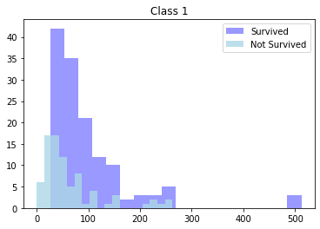
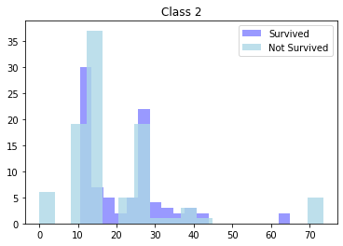
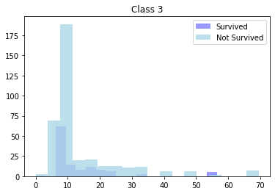
Data Analysis: Fare and Pclass
As shown by these three graphs, the most of the values of fare ranges from 10 to 100, while the maximum values reaches 500, so the scale is not evenly distributed and thus have to create categories accordingly.

Slide 15
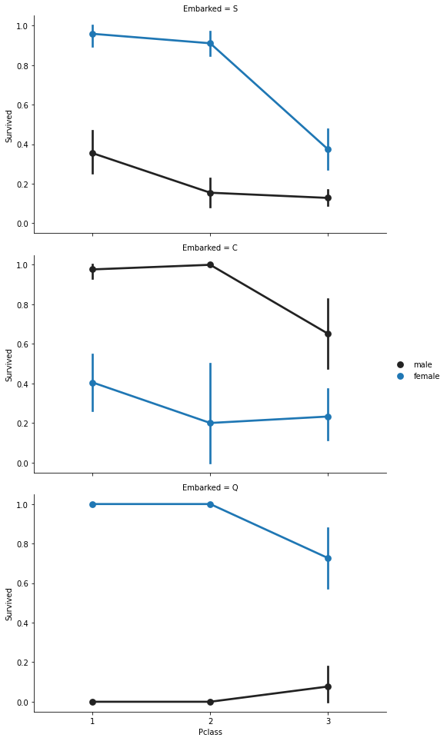
Data Analysis: Embarked, Pclass and Sex
The graph shows the survival of male and female as per Pclass and their port of embarkment.
Here, the probability of survival of female is higher than male for passengers who embarked from ports of Southampton and Queenstown, but the case is opposite when it comes to those passengers who embarked from the port of Cherbourg.

Slide 16
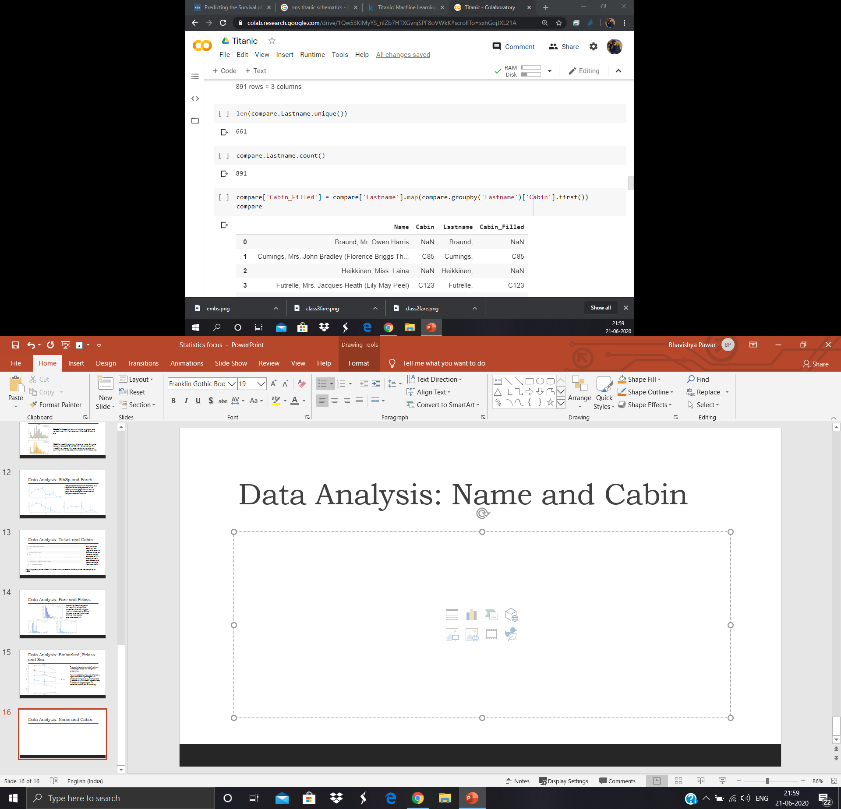

Data Analysis: Name and Cabin
Here, same as with fare, when you extract the last name out of passengers name, it is apparent that there are only 661 unique values out of 891, so we filled missing values of cabin as per last name.
Missing values decreased by 2.5%

Slide 17
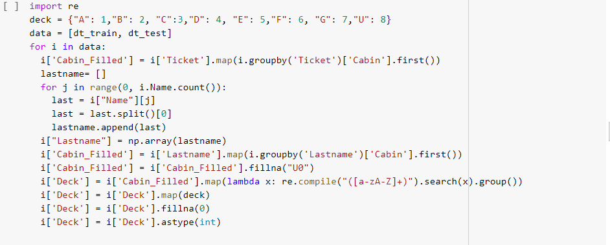
Data Processing: Missing values
For Cabin, when I saw the values, they were somewhat like C123, D182 ranging from letters A-G, which when I saw the Titanic schematic, it was apparent that the letters in the prefix of cabin coincided with the decks of the RMS Titanic. So, it is somewhat important factor for survival of the passengers.
So I extracted out the first letters of cabins and assigned a deck according to the cabin, and encoded it, and replaced the missing values as unknown deck.

Slide 18
Data Processing: Missing Values
For Age, I filled the missing values in accordance to standard deviation and mean of ages. By assigning a random value between (Mean + Standard deviation) and (Mean – Standard Deviation).
As for Embarked, it was easy as there was only two missing values, so I filled the missing values with the value that was appearing the most. Which was S, i.e, Southampton port of Embarkment.

Slide 19

Data Processing: Creating Categories
To get the most out of the Data, I categorized into various categories as per the titles from the names,
Creating the Categories: Officer, Royalty, Mrs, Miss, Mr, and Master
For others like sex I used LabelEncoding.
and for Age and fare, I created different categories using qcut function of pandas to evenly distribute the groups.

Slide 20
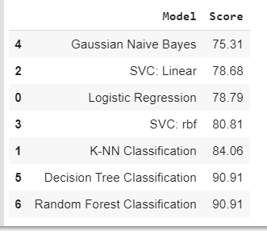
Training Different Machine Learning Models
After using 7 different machine learning models,
Logistic Regression
K-Nearest Neighbors Classification
Support Vector Classification with Linear Kernel
Support Vector Classification with Radial Bayes Function Kernel
Gaussian Naïve Bayes
Decision Tree Classification
Random Forest Classification,
The highest accuracy score we got was 90.91% with both Decision Tree Classification, and Random Forest Classification.

Slide 21
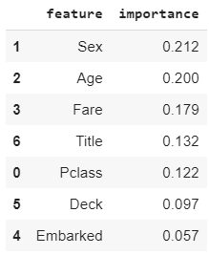
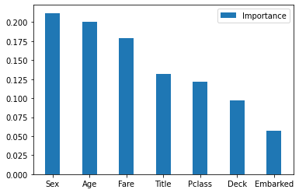
Feature Importance
After comparing the importance of features that amounts to the prediction. It is evident that sex, age and fare amounts more to the decision than embarked, but since all feature’s importance is more than 0.050 so, the model seems fine.

Slide 22
Summary
The input data contained 891 rows and 11 features. First we used the existing data to analyse the relation of that data and how it would be useful for the prediction. And then we used the analysis to clean the data, removing features which are not useful to the prediction.
We created some more relevant features such as title and deck. We used the pre-existing data like ticket and name to extract and fill missing values of features such as cabin, which made it possible to create a useful feature deck.
We transformed raw data to categories to scale the highly irrelevant range for features like age and fare, which both amounted to top three important features for the prediction. We trained seven different models from Logistic Regression to Random Forest Classification to find out the best fitting model for this problem, and Random Forest returned the accuracy score of 90.91 and was found to be the best model for the problem.

